Slide 1
Attacking the Kad network-real world evaluation and high fidelity simulation using DVN
Peng Wang, James Tyra, Eric Chan-Tin, Tyson Malchow, Denis Foo Kune, Nicholas Hopper and Yongdae Kim
Wiley Security and Communication Networks 2008
KAIST
SysSec Lab
Minjung Kim
Notes:
Hello, everyone. My name is Minjung Kim.
Today, I am going to talk about the paper named ~

Slide 2
Introduction
Notes:
This paper is about attacking the Peer to peer network.
Usually, p2p system is used in file sharing without any centralized authority.
In P2P system, each node has each different information.
And to operate the system well, nodes must be able to find the desired information they want to know, and they must be able to put or get data from the node.

Slide 3

P2P Systems
How to find the desired information?
  Centralized structured: Napster
  Decentralized unstructured: Gnutella
Napster.com
Napster
Match
Match
O
O
P
…
Query
QueryHit
Download
P: a node looking for a file
O: offerer of the file
A
B
X
Notes:
Then, how to find the desired information in P2P system?
There are several implementations that make node find appropriate data from the network.
The first one is Napster which is a centralized structured P2P system.
In Napster system, each node has its own information consisting of data and meta data.
And there is a central authority which is server.
The server knows everything about who owns what data.
So for example, I want to have BTS song named “DNA” as a MP3 file which is my favorite.
Then I will ask to the server that who has the song “DNA”?
Then the server will answer.
Then, I can try to connect with the node that the server told me and get the song file.
However, the Napster was failed because it can be vulnerable to single point of failure, and there was a legal issue about the copyright.
Therefore, the Gnutella was appeared as a decentralized unstructured P2P system.
There is no server like a Napster, which means if one node is killed, the system can keep going.
In Gnutella, each node is connected with neighbors.
So, if I want to get DNA song from Gnutellar, I will send query message to my neighbors.
Then my neighbor will flood the message to their neighbors and so on.
After that, the node that has the song file will be found.
And I can get the file from it.
It’s like a gossip protocol that floods the message to all nodes.
Furthermore, if eacn node has many neighbors, the system will be very robust.
It will be hard to destroy the system by deleting one or two nodes.
There is a movie which is made using this characteristics of Gnutella named Terminator.
John Karner who was the main character in the movie tried to kill the robots by shutting down the server.
However, in fact, robots were not controlled by one server but they were P2P system.
So in the movie, he said that he couldn’t shut down the system and the war will not be ended.
This is the video clip of that scene.
However, even though this system is strongly robust, this system is inefficient because almost all of the bandwidth will be used by sending query message instead of receiving data.

Slide 4
P2P Systems
How to find the desired information?
  Centralized structured: Napster
  Decentralized unstructured: Gnutella
  Decentralized structured: Distributed Hash Table
K V
K V
K V
K V
K V
K V
K V
K V
K V
K V
K V
retrieve (K₁)
Notes:
Therefore, to be more efficient, distributed hash table which is called DHT is appeared, and it is a decentralized unstructured P2P system.
In DHT, each node has each data that is formed as a hash table with <key, value> format.
DHT provides a lookup service with these hash tables so that any participating node can efficiently get/put the value of data from the associated hash table with a given key.
It is much more efficient than Gnutella because the query message doesn’t have to be reached to all nodes.

Slide 5
DHT: Terminologies
Every node has a unique ID: nodeID
Every object has a unique ID: key
Keys and nodeIDs are logically
arranged on a ring (ID space)
A data object is stored at its root(key)
and several replica roots
  Closest nodeID to the key (or successor of k)
Range: the set of keys that a node is responsible for
Routing table size: O(log(N))
Routing delay: O(log(N)) hops
C
A
Q
X
D
B
Y
R
k
(k,v)
Notes:
** distance !!!!! (root) the closest nodeID will be the root node that store the data whose key is k.
More specifically, to understand the DHT, there are some terminologies that we have to know.
nodeID is the ID that each node has uniquely.
Usually, nodeID is set as a hash of each node’s IP address.
And every object has its own unique ID which is called key.
Keys and nodeIDs are logically arranged on a ring which is called ID space altogether.
For example, if the system uses SHA1 as a hash function, then the ID space will be 0 to 2 to the power of 160 -1.
A data object is stored at its root.
And the root is the closest nodeID to the key.
However, there are large churn in/out rates in the network, so the backup is needed.
Therefore, the data is also stored in neighbors of the root which is called replica root.
Next, the range is the set of keys that a node is responsible for.
So, for example, this ring is the ID space.
And the circles are nodeIDs and there is a data which is represented as k.
In this example, the root is node R because it is the closest.
Also, as a replica root, node B also stores the data with key K.
And if my nodeID is A, then I will somehow find the root and retrieve the data with key K.
The important thing in DHT is that when each node has O(log n) neighbors, then it will find the desired data in O(log n) hops.
Also, because usually the data key is hash of the meta data, if I know the meta data of the information that I want to find, I can know the key, which means content addressable.

Slide 6
Main Questions?
Any P2P system is used for finding desired information
Questions
- Routing attacks on DHT? What does it mean?
- Is the most popular DHT secure against routing
attacks?
- What are the resources?
- How efficient is the attack?
- How to fix it?

Slide 7
Background
Notes:
Now, let’s look at the target system in detail.

Slide 8
Target P2P System
Kad
  A peer-to-peer DHT based on Kademlia
Kad Network
  BitTorrent
  Overlay built using eD2K series clients
    eMule, aMule, MLDonkey
    Over 1 million nodes, many more firewalled users
  BT series clients
    Overlay on Azureus
    Overlay on Mainline and BitComet
Notes:
So, Kad is a peer-to-peer DHT based on Kademlia.
And there are many applications that use Kad Network.
This paper targeted this system, and so we wiil see the attack of this system.

Slide 9
Kademlia Protocol
10101100
An entry in k-bucket in i-th level shares at least i-bit prefix with the nodeID
d(X, Y) = X XOR Y
ex) 10101100 XOR 11001011
= 01100111
Add new contact if
  - k-bucket is not full
01001011
123.24.3.1
K bucket
00100101
23.37.12.13
0
01011010
311.1.3.4
…
1
01000001
129.5.3.1
11011011
0
11000100
1
11111110
…
11010001
0
10001011
1
10010100
10001110
…
10000001
0
1
Notes:
In here, I’ll explain the concept of Kademlia and Kad protocol.
Indeed, the Kademplia protocol is one of the algorithm implementing DHT.
Please remind that because this is DHT, each node has O(log n) size routing tables and can find the data within O(log n) hops.
Therefore, it is really important that how each node has the routing table.
In case of Kademlia,
the whole node is structured like this tree structure something like biased.
And each node has a unique ID in the ID space and each node has a k bucket routing table.
Usually 20 buckets in 1million nodes.
And the rule of the distance of two nodes is calculated by ‘bitwise XOR’ using the two node IDs.
For example, if my nodeID is 10101100 and my node wants to find 11001011 node.
Then, first bit xor goes 0 and second bit goes 1.
In addition, k-bucket with ith level means that there are nodes that have at least i bit prefix-matched nodeID in the bucket.
In this figure on the right side, the first k bucket has 0 bit prefix matched node IDs with my node ID which is 10101100.
And the second k bucket has 1 bit prefix matched node IDs, and so on.
Furthermore, if the k-bucket is not full, yet then new contact can be added on the bucket.

Slide 10
Kademlia Protocol
10101100
11001011
01001011
123.24.3.1
KADEMLIA_REQ
K bucket
00100101
23.37.12.13
0
11000100
01011010
311.1.3.4
…
1
KADEMLIA_RES
01000001
129.5.3.1
11011011
0
KADEMLIA_REQ
11000100
1
10101100
11111110
…
11001100
11010001
KADEMLIA_RES
0
10001011
1
SEARCH_REQ
10010100
10001110
…
11001010
10000001
0
Return ‘matches’
1
Iterative, parallel, prefix-matching routing
Replica roots: k closest nodes
Notes:
So the Kademlia protocol runs like this.
When I want to find node ID 11001011 which is written as a blue color, I firstly have to find the closest node ID in my routing table.
In here, it is a 11000100.
And then, I send query to the 11000100 node about whether it has any the closest node ID with 11001011 in its routing table.
It will return something.
And then, my node will ask again about the 11001011 node to recently returned node… and so one. When the closest node is found, this process will be end.
In the real network, node queries to each three nodes in parrallel to improve robustness against node churn rates and to improve the look-up speed,
Therefore, I will send query messages to three the closest nodes and receive the messages including other nodeIDs. And send the messages to those three the closest nodes among them and so on iteratively
So, we call Kademlia protocol as parallel, iterative, prefix-mathcing.
===================================================================================================================================
Routing to a given KAD ID is done in an iterative way. To improve robustness against node churn that can result in stale routing table entries and to improve and look-up speed, the requesting peer P runs three parallel routing lookups for a given key at the same time: A peer P first consults his routing table to determine the three peers closest to the KAD ID. P sends route requests to these three peers, which may or may not return to P route responses containing new peers even closer to the KAD ID, which are queried by P in the next step. The routing lookup terminates when the returned peers are further away from the KAD ID than the peer returning them.

Slide 11
Kad Protocol
10101100
0
1
0
1
1
0
1
0
1
0
1
0
1
0
1
0
0
1
1
0
1
0
1
0
1
0
1
0
1
0
15
14
13
12
11
10
9
8
7
6
5
4
3
2
1
0
0
1
0
1
Wide routing table ➔ short routing path
No restriction on nodeID
Replica root: |r, k| < δ
K bucket in i-th level covers 1/2^{i} ID space
K buckets with index [0,4] can be split if new contact is added to full bucket
Notes:
This is the Kad protocol which is a p2p DHT based on Kademlia protocol.
The main difference between Kad and Kademlia is the structure of routing table.
In case of Kademlia, the routing table starts with 0 bit prefix matching.
But in case of Kad, it starts with at least 4 bit prefix matching and this will make shorter routing path than Kademlia protocol.
As the routing table gets fatter, # of hops will be decreased.
In addition, there is no restriction on nodeID in Kad.
Therefore, anything can be an ID.
Also, the replica roots of data item <x,v> are nodes with an ID r such that |r,k| < δ ωηεν δ ισ α σεαρχη τολερανχε ηαρδ−χοδεδ ιν τηε σοφτωαρε.

Slide 12
Vulnerabilities of Kad
No admission control, no verifiable binding
  An attacker can launch a Sybil attack by generating an arbitrary number of IDs
Eclipse Attack
  Stay long enough: Kad prefers long-lived contact
  (ID, IP) update: Kad client will update IP for a given ID without any verification
Termination
  Query terminates when A receives 300 matches.
Timeout
  When M returns many contacts close to K, A contacts only those nodes and timeouts.
Notes:
So the vulnerabilities of Kad is simple,
There are 4 points in here.
First, no verifiable binding means, in Kad protocol, there’s no relation between host and its ID.
Making several nodes from one IP or making my nodeID as “Stupid” are all possible.
Therefore, the Sybil attack may happen.
Second, Kad prefers not to change node’ ID because there is large number of churns.
So in this case, peer who is downlaoding some file moves another network then the node simply sends the message like “my node’s IP is changed” then it works without any verification.
Therefore, like an eclipse attack, attacker can change nodeID’s ip address to the attacker’s address.
Third, if node A receives more than 300 matches, then query terminates. So if an attacker sends more than 300 faulty matches earlier, that peer would have no meaningful results.
Fourth, if the time is out or there is the closest node ID, the procedure will be ended ignoring other results.

Slide 13
Attacking the Kad Network
Notes:
So, with those 4 vulnerabilities of Kad, let’s see how the network can be attacked.

Slide 14
Attack Model
Attack goal
Degrade the service of the Kad network, by causing a significant fraction
of all keyword as well as node searches to fail.
Attacker
- Attacker controls only end-system
- Does not require corruption or misrouting of IP-layer packet between
honest nodes
- Attacker’s primary cost is in bandwidth, and it has enough
computational and storage resources
Notes:
Let’s see who are the attackers and what’s their goas.
The goal of this attack is degrading the service of the Kad network, by causing a significant fraction of all keyword as well as node searches to fail.
And in this paper, the autor assumed that the attacker is just one of the P2P client.

Slide 15
Actual Attack
Preparation phase
  Backpointer Hijacking: honest A, attacker M
    Learns A’s Routing Table by sending appropriate queries
    Then, change routing table by sending the following message.
1100
123.24.3.1
KADEMLIA_REQ, A, key : 1100
K bucket
1010
23.37.12.13
A
M
1011
311.1.3.4
…
1111
129.5.3.1
KADEMLIA_RES, M, 1000, 1010 …
…
Hello, B, IP_{M}
0xD00D
IP_{M}
A
M
IP_{B}
Notes:
In the preparation phase, attacker gets the information about node A’s routing table by querying appropriate queries.
For example, if node M sends KADEMLIA_REQ message with 1 bit prefix matched node ID with the A’s nodeID, then node A will return close nodeIDs that A has in its routing table.
After attacker nodes learn the routing table of ndoe A, it also hijacks a certain fraction of the pointers in A’s routing table.
Let’s suppose that node A has honest node B in its routing table.
In Preparation phase, simply attacker M sends the hello message to A that node B’s IP address is changed to IP of node M. Then node A will update its routing table like this.
So attacker sends this message to all nodes that exist in its routing table.
Remember that in Kad protocol, messages sent by the Kad nodes are not verified.
Therefore, until now, the attacker makes queries from node A come to the attacker node.

Slide 16
Actual Attack
Execution Phase
  Termination condition
  Keyword terminates when the querier A receives more than 300
  keyword matches in response to SEARCH_REQ messages
  => malicious node sends a list of 300 bogus matches in reponse
  Timeout condition
  No reply for 25 seconds, it will stop sending message.
  => Provide many non-existing contacts
Notes:
For each KADEMLIA_REQ query message received, a malicious node M intentionally generates a contact whose ID is a replica root, with IP and port fields that are set to point to itself.
Upon receving this reply, the node A will send a KADMLIA_REQ to the malicious colluder to find more replica roots.
Then the colluder sends message that shows it is alive without introducing other colluders.
And in execution phase, the attacker has to fail the query messages.
In Kad protocol, it would be dangerous for an attacker to fail to respond to a KADEMLIA_REQ, because this would cause the querier to drop the malicious node from its routing table. Therefore, attacker has to respond anyway when it fail the query.
There are two ways to make query fail .
First, malicious node sends a list of 300 bogus matches in reponse. Then the node A will stop sending any request messages even though it hasn’t reached a live honest replica root, yet.
Second, exploit the timeout condition in Kad protocol.
Recall that if all three of the closest nodes at a given step timeouts, a Kad client will find its closest backup contact, and try to contact that node.
And after repeating this process for 25s, it will stop the process.
Therefore, as an example, when the attacker node M receives a KADEMLIA_REQ, it generates a response message with 30 contacts with IP and port which are set as Kad node not running with node ID that is really close to the key.
Then, node A will insert them in its list of possible contacts at the beginning of its list because these contacts are very close to the key and then node A will send KADEMLIA_REQ message to those contacts in sequence.
However, they will not respond because they are not running.
Therefore, after 25 seconds, the node A will stop trying more contacts without any results.

Slide 17
Attack Evaluation
Notes:
In this section, I will explain about the result of attack evaluation.

Slide 18
Summary of Estimated Cost
Assumption
  Total 1M nodes
  860 routing table entries
  100 Mbps network link
Preparation phase cost
  41.2GB bandwidth to hijack 30% of routing table
  Takes 55 minutes with 100 Mbps link
Execution phase cost
  100 Mbps link is sufficient to stop 65% of WHOLE query messages.
Notes:
Doing large scale simulation, this paper assume that there are total 1M nodes,….

Slide 19
Large Scale PlanetLab Experiment
11,303 ~ 16,105 Kad nodes running on ~500 PlanetLab machines
Comparison between expected and measured
  keyword query failures
  Number of messages used to attack one node
  Bandwidth usage
Notes:
This is the result of the experiment.
Simply we can see that if hijacked contacts increases, then also the percentage of query failure is increased.
Fig.6(a) shows the comparison between expected and measured keyword query failures, where we say a query fails if the victim does not find any normal Kad nodes within the search tolerance of the target ID.
In the 10, 20, and 30 % cases, the measured frequency is higher than the expected number.
But, in the 40% case, the measured frequency is lower than the expected.
Fig 6(b) and (c) show the attacker’s message and bandwidth costs.
The attack cost was slightly less than expected.

Slide 20
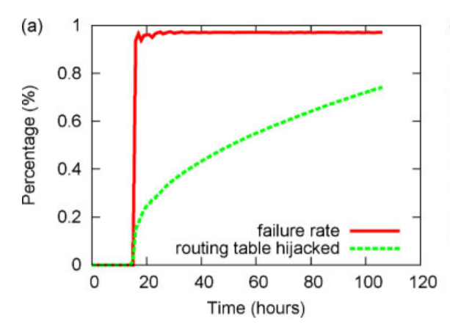
Large Scale Simulation
50,000 nodes and 50 attackers with DVN
Focus on control plane (routing process)
Notes:
Because in the real Kad network, number of nodes are limited to a network size of 16,000 nodes, they simulate the attack with DVN with 50,000 ndoes.
And in this simulation, it focuses on the control plane that controls the routing process rather than keyword search which is a data plane.
And the result shows that only 0.1% of the network being malicious, and hijacking only 15% of every node’s routing table, almost every routing request is hijacked.

Slide 21
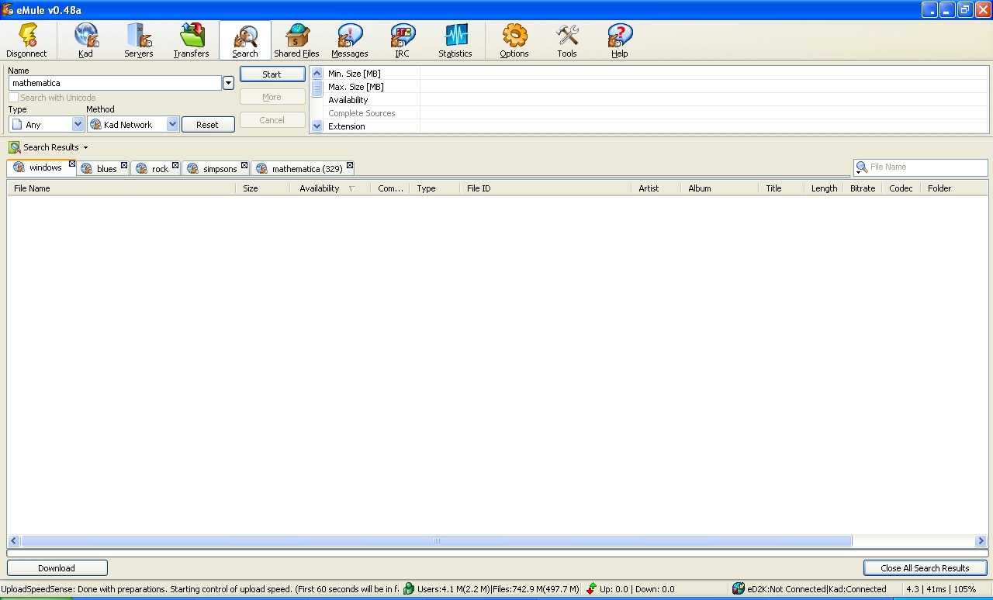
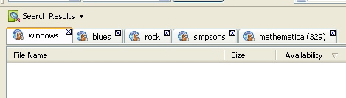
Screen Shots
Notes:
This screen shot is provided by Yongdae professor.
This is the experimental results in those attack in eMule.
As you can see, this node can’t get any result of windows , blues, rock, simpson.
Even though in case of mathematica, it fails but anyway almost all of the files were failed by this attack.

Slide 22
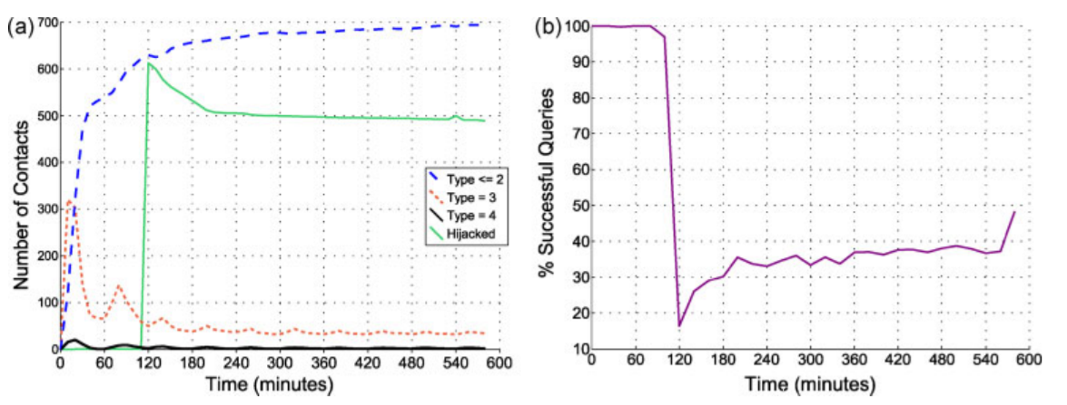
Reflection Attack
Fill node A’s routing table with A itself.
A
A
C
C
C
IP_{C}
C
…
Hello, X, IP_{A}
…
G
IP_{G}
G
Attack
G
G
Notes:
However, the disadvantage of the previous attack is that the attacker needs an ongoing cost of around 100Mbps network link.
Making node’s entries in the routing table point to the victim itself rather than to the attacker is more efficient. This is called reflection attack.
This reduces the ongoing cost of the attack, while leaving the victim unable to contact any other Kad nodes.
Because there is no IP and host authentication, a hijacked node will continue to send messages to itself and reply to itself.
The author did the reflection attack experiment with 48 victim nodes in the real network.
The figure (a) shows the average number of contacts in the routing table for the 48 victim nodes.
The # of contacts are further divided by a type and whehter they were hijacked.
After 2h, the hijacking attack starts.
The result shows that the number of hijacked contacts increase rapidly, and then decreases as the victim recover slowly.
The type 2 contacts incldue the number of hijacked contacts.
We can see that even after 8 h, roughly 70% of the victim’s contacts still point back to itself.
It suggests that at the full network scale, a second round of hijacking may be sufficient to fully disconnect Kad.
They also measured that how the query success rate of the victims changed over the course of the attack.
(b) shows that the fraction of successful queries is equal to the fraction of non-hijacked “type 2” nodes.
In addition, they proposed that the attacker needs 166Mbps of downlink capacity and 117 Mbps uplink capacity to do the reflection attack on the entire Kad network in 1 h which is the little bandwidth usage.

Slide 23
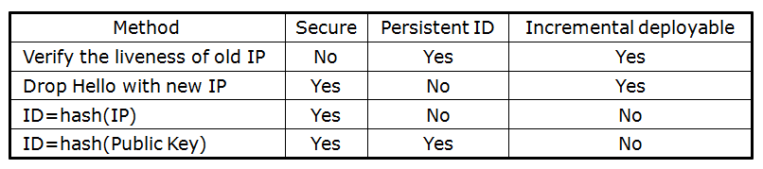
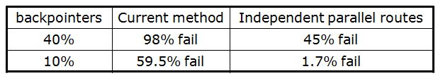
Mitigation
Identity Authentication
Routing Corruption
- 3 parallel lookups but they are not independent
Notes:
In summary, there are two weakness in Kad.
The first one is weak identity authentication.
Because of this, hijacking back pointer was possible.
Another thing is the fact that Kad send query messages to the closest contact with the key ID.
Because of this, hijacking the query message by impersonating as a node that has the closest nodeID to the key was possible.
In this paper, it suggested two mitigations.
The first one is mitigating the identity authentication.
- trust but verify: see if node B is still running with the previous IP and port. If node B is still running with the previous IP and port, then A will not update its routing table.
Simply disregard messages when nodes change the IP address of a pointer. If a node goes offline and comes back with a different IP address, it will be dropped from any routing tables it is on, but can retain its own table.
But, this cannot eliminate hijacking rate. Since Kad nodes have high churn rates, it is likely that many entries on A’s routing table will be offline, and attacker can hijack these entries. But, the cost will increases because attacker will expend time and bandwidth looking for offline.
Those two methods are incrementally deployable.
However, these do not protect against hijacked intermediate contacts that might be returned by older clients during a query, or against Sybil attacks that claim an ID close to an expired routing table entry.
Node B could use hash(IP) as its node ID. It can prevent Sybil attack or hijacking. But can’t support mobility
Use hash(PK). Secure. But requires a critical mass of peers running authenticated clients.

Slide 24
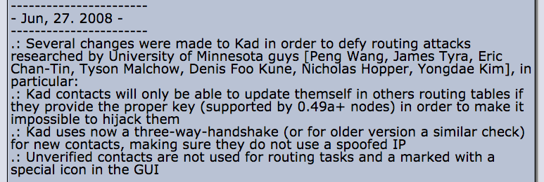
Then
Notes:
Because of this paper, Kad developer tried to change the protocl.
However, even though Kad2 tried to improve its security, the routing attack that this paper proposed still work.
Now, an easy change to the code prevents hijacking attacks in the latest version.

Slide 25
Related Work
Sit, E., & Morris, R. (2002, March). Security considerations for peer-to-peer distributed hash tables. In International Workshop on Peer-to-Peer Systems (pp. 261-269). Springer, Berlin, Heidelberg.
Castro, M., Druschel, P., Ganesh, A., Rowstron, A., & Wallach, D. S. (2002). Secure routing for structured peer-to-peer overlay networks. ACM SIGOPS Operating Systems Review, 36(SI), 299-314.
Fiat, A., Saia, J., & Young, M. (2005, October). Making chord robust to byzantine attacks. In European Symposium on Algorithms (pp. 803-814). Springer, Berlin, Heidelberg.
Notes:
There are many works about DHT.
The first paper presented attacks on DHT and applications built on it.
The second paper designed a framework for secure DHT routing.
The third paper defined a Byzantine join attack model on the DHT.
While several works report on DHT routing attacks, none address Kad or Kademlia specifically, and none are tested on a widely-deployed DHT.

Slide 26
Work After This Work
Cholez, T., Chrisment, I., & Festor, O. (2009, June). Evaluation of sybil attacks protection schemes in kad. In IFIP International Conference on Autonomous Infrastructure, Management and Security (pp. 70-82). Springer, Berlin, Heidelberg.
Yu, J., Fang, C., Xu, J., Chang, E. C., & Li, Z. (2009, September). ID repetition in Kad. In Peer-to-Peer Computing, 2009. P2P'09. IEEE Ninth International Conference on (pp. 111-120). IEEE.
Fantacci, R., Maccari, L., Rosi, M., Chisci, L., Aiello, L. M., & Milanesio, M. (2009, June). Avoiding eclipse attacks on kad/kademlia: an identity based approach. In Communications, 2009. ICC'09. IEEE International Conference on (pp. 1-5). IEEE.
Apostolaki, M., Zohar, A., & Vanbever, L. (2017, May). Hijacking bitcoin: Routing attacks on cryptocurrencies. In Security and Privacy (SP), 2017 IEEE Symposium on (pp. 375-392). IEEE.
Blond, S. L., Manils, P., Abdelberi, C., Kaafar, M. A. D., Castelluccia, C., Legout, A., & Dabbous, W. (2011). One bad apple spoils the bunch: exploiting P2P applications to trace and profile Tor users. arXiv preprint arXiv:1103.1518.
Notes:
Many works have been published about the Kad and Kademlia protocol after this work. ~
Also, in this paper, it usually covers the routing attack, sybil attack and eclipse attack in eD2K series clients that use Kad protocol.
However, works after this work cover several other applications based on Kad network.
The first paper above systematically study P2P botnets along multiple dimensions.
And the second paper studied routing attack on the Bitcoin network
The third paper studied the eclipse attack on Ethereum.

Slide 27
Future Work
Ethereum uses a variant of Kademlia protocol in node discovery.
Make nodeID with its public key
Try to connect with the closest node as a peer
→ Same problem in here?
Why no verification mechanism in the first place?
Notes:
This work was interesting to me because the Ethereum p2p network has been implemented with the Kademlia protocol.
They use each node’s public key as a node ID and they try to connect peers with Kademlia protocol.
And because it is based on the Kademlia, I wonder that there can be the same problems in here, too.

Slide 28
Conclusion
Deny service to a large portion of the Kad network with only 100Mbps of bandwidth
The attack was successful and efficient.
This attack is more efficient than currently known attacks such as Sybil and Index Poisoning
Introduce new simulator, DVN.
Notes:
Conclusion! ~

Slide 29
Thank you!!!

